Slide 1

Learning PowerShell
Master Microsoft's powerful automation tool. This session covers PowerShell fundamentals through advanced CI/CD integration.

Slide 2
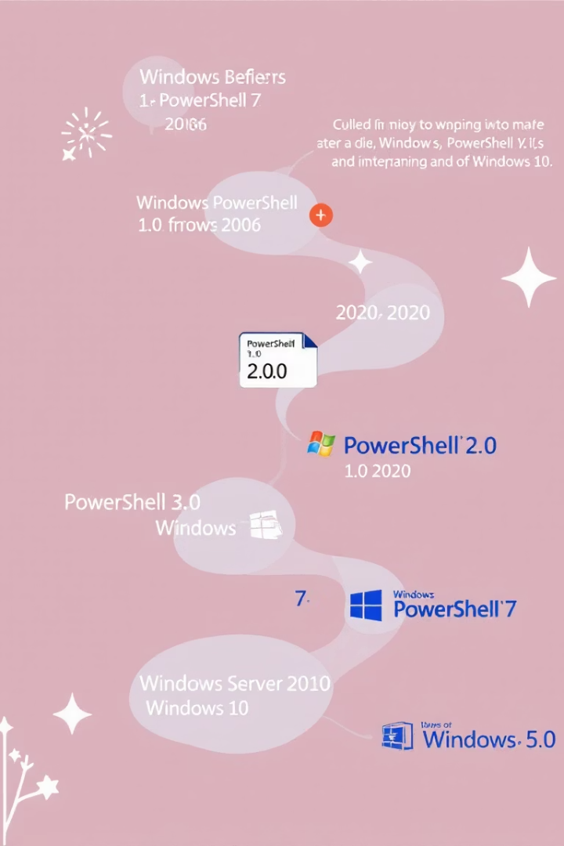

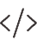

PowerShell: History and Editions
2006: Windows PowerShell
Built on .NET Framework
Windows-only scripting environment
2016: PowerShell Core
Open-source rewrite on .NET Core
Added cross-platform capabilities
Today: PowerShell 7+
Unified experience across platforms
Enhanced compatibility with classic modules

Slide 3
Comparing Shells
PowerShell
CMD
Bash
Python
Object-based pipeline
Simple text processing
Text-stream oriented
General programming language
Deep Windows integration
Line-by-line execution
Unix-focused toolset
Requires libraries for system tasks
Structured data handling
Limited scripting
Mature scripting capabilities
Full development capabilities

Slide 4

Why Use PowerShell?
Complete Automation
Object Pipeline Power
Manage all aspects of Windows systems, including GUI-only tasks.
Work with structured data instead of text parsing.
Access system internals unavailable to other tools.
Build complex workflows with simple commands.
Enterprise Integration
Cross-Platform Support
Seamless control of Active Directory, Exchange, and Azure.
Run the same scripts on Windows, Linux, and macOS.
Consistent management across on-premises and cloud.
Manage heterogeneous environments with one toolset.

Slide 5




PowerShell Core Command Structure
Cmdlets (Verb-Noun)
Clear naming convention: Get-Process, Stop-Service
Consistent patterns across all commands
Parameters
Modify command behavior: -Name, -Path
Support named, positional, and switch formats
Pipeline
Connect commands with | symbol
Pass entire objects between commands
Example
Get-Process | Where-Object { $_.CPU -gt 100 }

Slide 6








Exploring PowerShell with Help Commands
Get-Help
Get-Command
Access built-in documentation for any command
Discover available cmdlets and functions
Get-Member
Update-Help
Explore object properties and methods
Download latest documentation

Slide 7
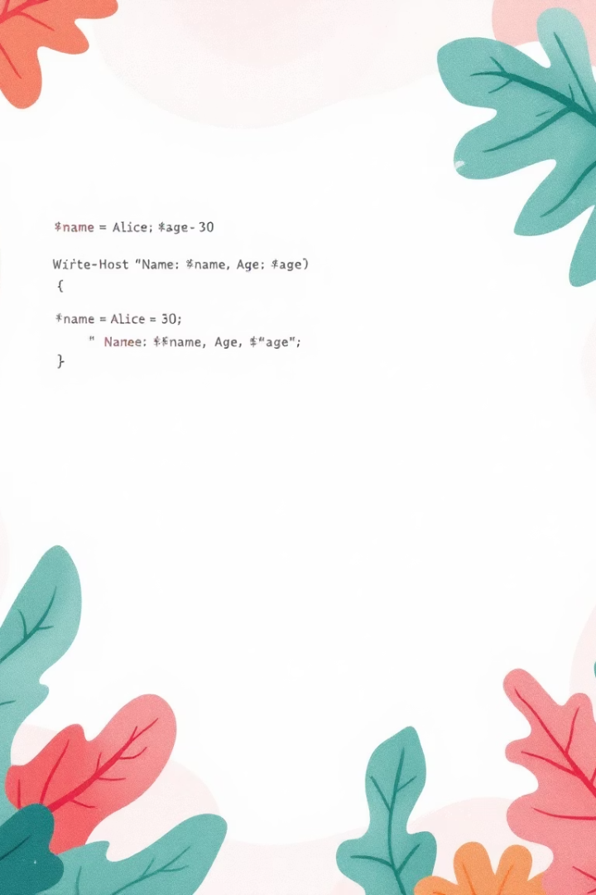
Variables, Data Types, and Interpolation
Variable Declaration
$name = "Alex"
Number Variable
$count = 42
Array Creation
$colors = "red", "blue", "green"
Object Creation
$user = @{Name="Alex"; Age=30}
String Interpolation
"Hello, $name! You are $($user.Age) years old."

Slide 8
Control Structures and Scripting Basics
Conditional Logic
Make decisions with if, else, and switch statements.
Test conditions with comparison operators like -eq, -gt, -contains.
Loops and Iterations
Process collections with foreach, for, while, and do-until.
Iterate through arrays, processing items one by one.
Functions and Modules
Create reusable code blocks with function keyword.
Package related functions into script modules.

Slide 9




PowerShell in System Administration
File System Management
Copy-Item, Remove-Item, Get-ChildItem for file operations.
Service and Process Control
Start-Service, Stop-Process, Set-Service for system tasks.
User and Group Administration
New-LocalUser, Add-ADGroupMember for identity management.
Remote Management
Enter-PSSession, Invoke-Command for remote administration.

Slide 10








PowerShell and CI/CD Pipelines
Deployment Automation
Automate application releases
Testing Integration
Run and validate tests
Build Processes
Compile and package code
Source Control
Manage code repositories

Slide 11
Understanding Try/Catch/Finally Structure
Try Block
Catch Block
Contains code that might generate errors. The potential problem area to monitor.
Handles terminating errors from the Try block. Your error response system.
Finally Block
Always executes regardless of errors. Perfect for cleanup operations.

Slide 12








Effective Catch Block Implementation
Target Specific Errors
Catch exactly what you need to handle
Access Error Details
Use $_ or $PSItem variables
Log with Context
Record what happened and why
Implement Recovery
Fix issues when possible

Slide 13








The Finally Block
Guaranteed Execution
Resource Cleanup
Always runs regardless of errors in Try block
Releases memory and system resources
State Consistency
Connection Closing
Maintains system integrity regardless of errors
Ensures database and network connections terminate properly

Slide 14





Real-World Implementation Examples
User Account Management
Handle creation failures with informative messages to administrators.
File Operations
Recover gracefully from permission issues and locked files.
API Interactions
Manage timeouts and authentication failures with proper retry logic.
Database Operations
Ensure transactions roll back properly on failures.

